Slide 1


An efficient numerical target strength prediction model: validation against analytic solutions
Laurent Fillinger, Marten J. J. Nijhof, Christ A.F. de Jong
2nd International conference and exhibition on Underwater Acoustics, UA2014, Rhodes, Greece, June 22-27, 2014

Slide 2
Outline
Rapid Acoustic Signature Prediction (RASP) model
Based on Kirchhoff diffraction theory
Extended to include (to some extent) elastic response and multiple scattering
Validation for simple rigid structures
Cylinder
Sphere
Conclusion
Need for further validation / BeTSSi II

Slide 3
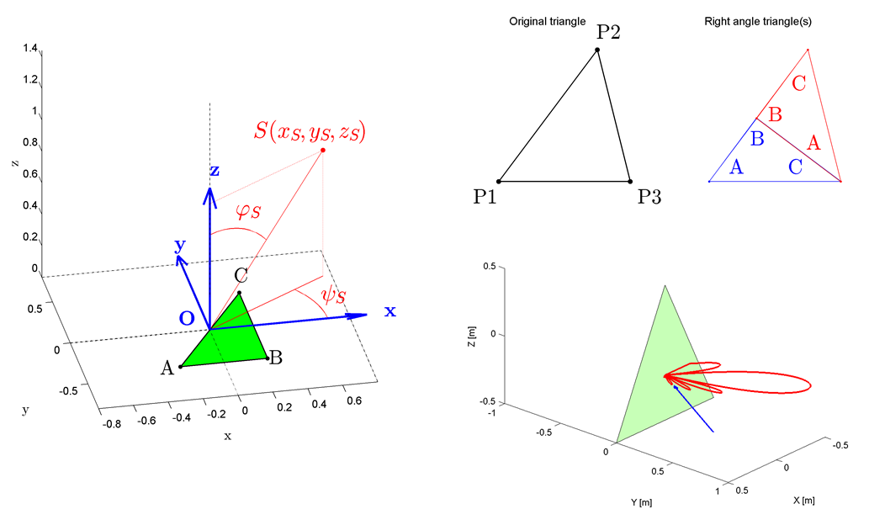
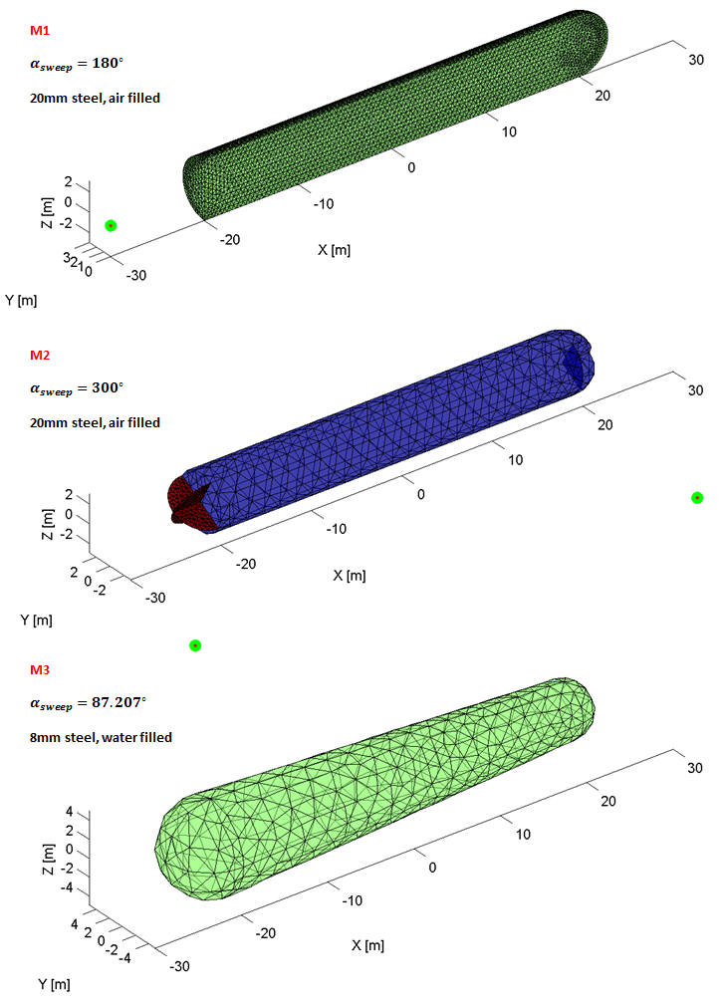
Rapid Acoustic Signature Prediction (RASP) model
Object decomposed into triangular elements
Response of object = superposition of the triangle responses
Response of a rigid triangle
Pressure field in arbitrary position for a source at an arbitrary position and with arbitrary frequency
Far field and high frequency assumptions

Slide 4


Rapid Acoustic Signature Prediction (RASP) model
Response of a an elastic triangle:
Rigid response modulated by reflection/transmission $R$/$T$ coefficient
$R$/$T$ coefficient of infinite plate
Multi-layers
Angle dependence
$$p_{R}$$
$$p_{T}$$
$$θ_{R}$$
$$θ_{T}$$
$$\begin{matrix}R=p_{R}/p_{I} \\ T=p_{T}/p_{I}\end{matrix}$$
$$θ_{I}$$
$$p_{I}$$

Slide 5





Rapid Acoustic Signature Prediction (RASP) model
No ray-tracing
Response = superposition of response of visible elements
Visibility approximation:
Triangle with center $O$ and outward normal $\vec{N}$ is visible from point $P$ if $\vec{N}∙\vec{PO}<0$
Visibility of an element is assumed independent of the parameters of the other elements → very fast
Valid only for convex structures
Internal parts: declared as occluded by another part
Response scaled by $T^{2}$ of the occluding part
$$\vec{N}$$
$$O$$
$$\vec{PO}$$
$$P$$

Slide 6
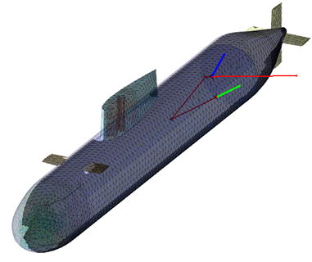
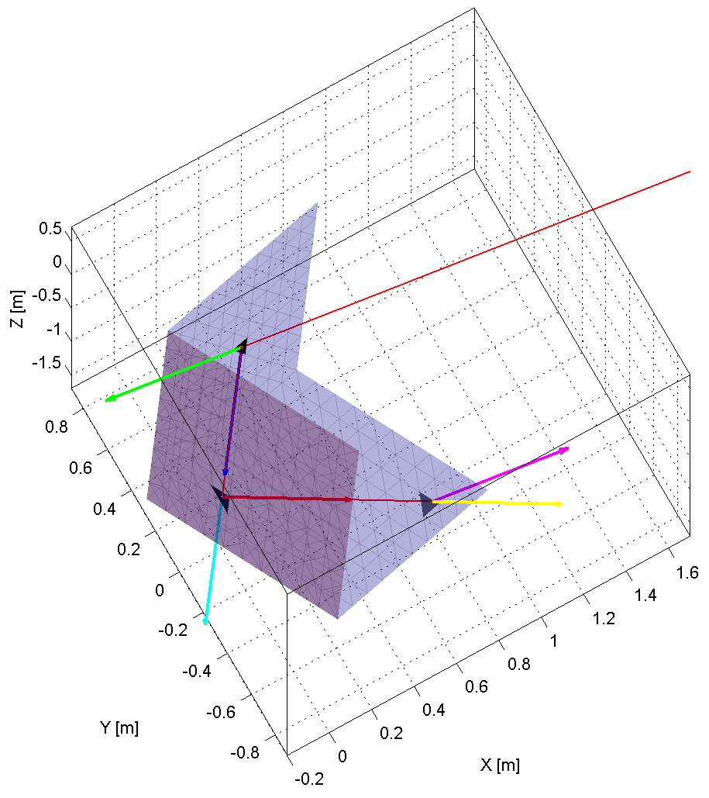
Rapid Acoustic Signature Prediction (RASP) model
With ray-tracing
Response = superposition of response of rays starting and ending on visible elements
Visibility approximation:
A triangle is assumed fully visible or fully occluded, depending on whether its center is visible or occluded
Visibility of an element is function of the parameters of every other elements
Valid also for concave structures

Slide 7
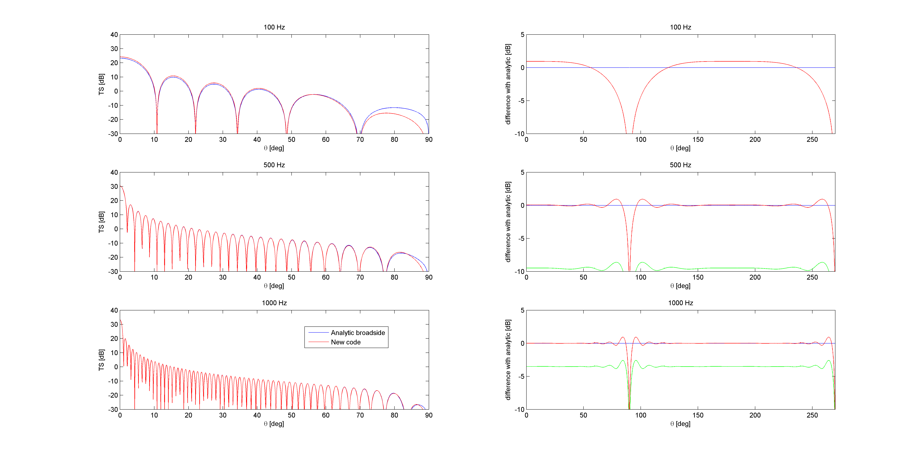

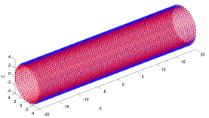

Response of a rigid cylinder
Monostatic target strength formula from Kerr: ${TS}_{cyl}=10\log_{10}\left(\frac{aL^{2}}{2λr_{ref}^{2}}{\left[\frac{sin\left(kLsinθ\right)}{kL sinθ}\right]}^{2}cosθ\right)$
Analytic formula assumes λ<<R and λ << L and near broadside
Good agreement between RASP and analytic formula
Length $L =40$m, radius $a=4$ m

Slide 8
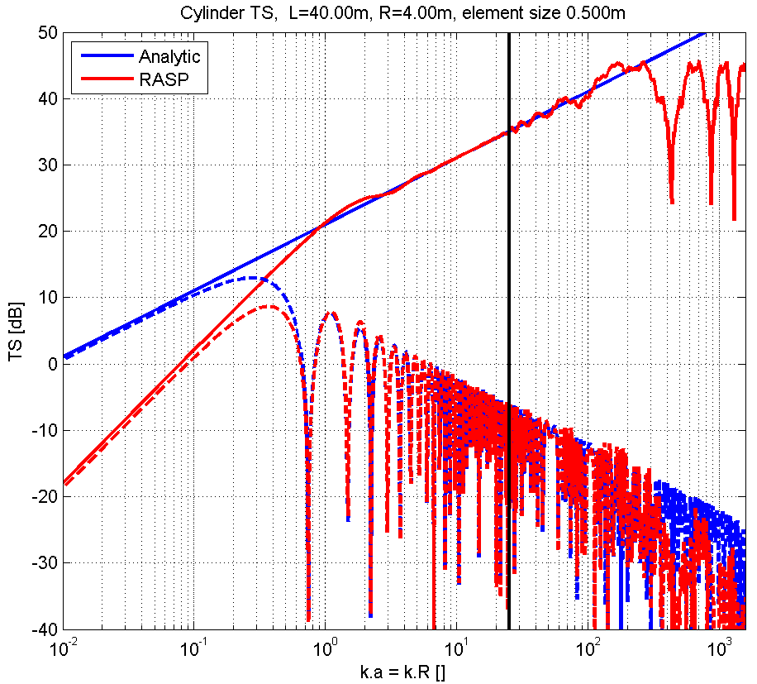
Response of a rigid cylinder – Frequency
Response at broadside and at 25° from it.
LF (k.a<1). Analytic: 10dB/dec, RASP: 20dB/dec → Both wrong (good is 40dB/dec)
MF: RASP and analytic both good
HF: (k.a>πR/δ, δ=element size)
Analytic ok
RASP ok but mesh fails!
Fixed by mesh refinement (at the expense of memory and computation time)
0°
HF: mesh too coarse
25°

Slide 9
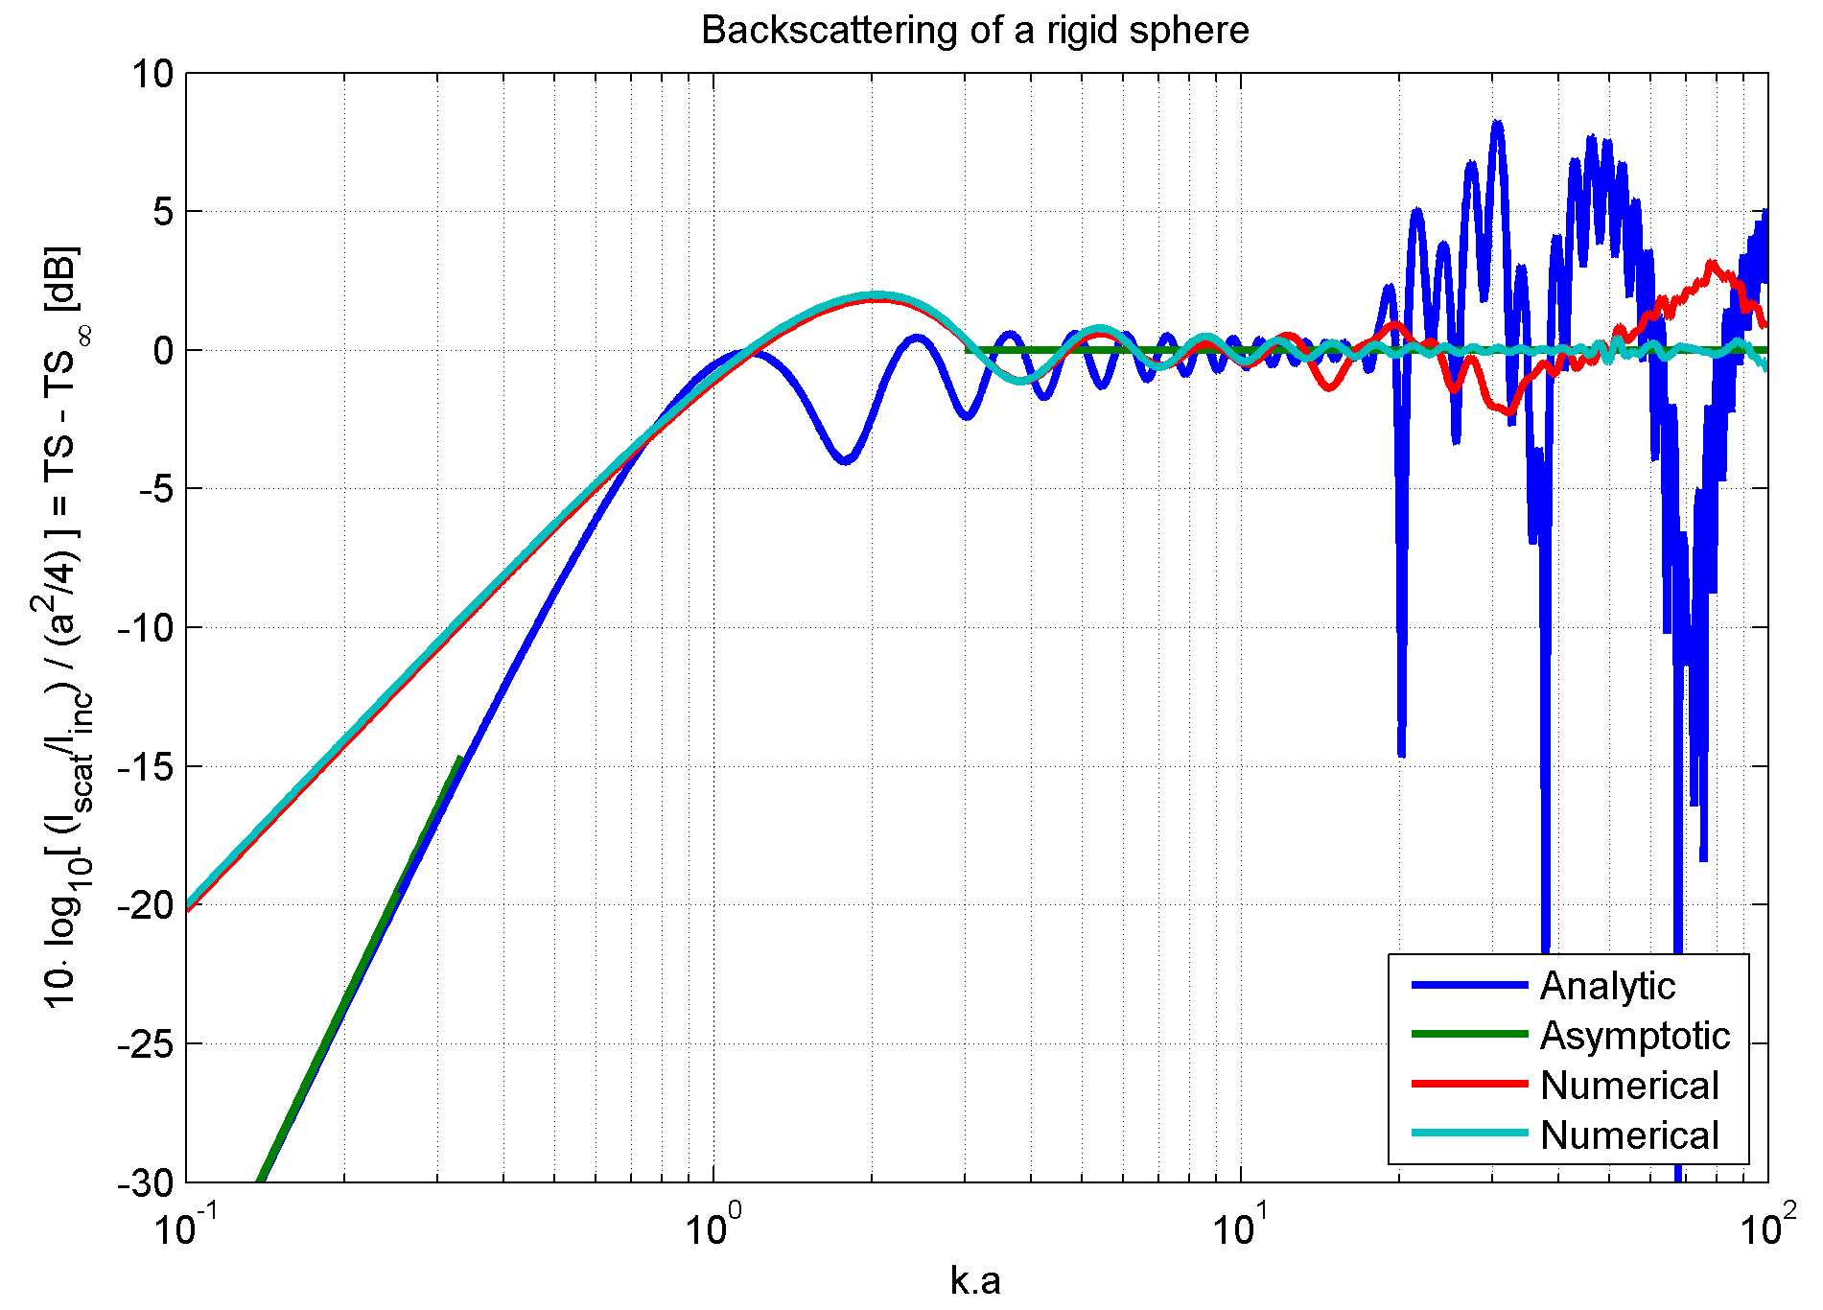
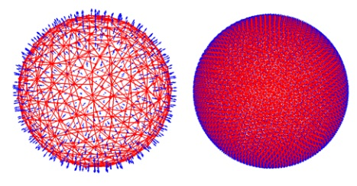
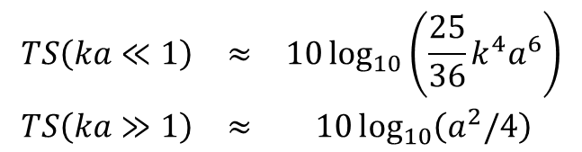
Response of a rigid sphere
Exact analytic (truncation of infinite sum makes results wrong in HF) Asymptotic:
LF: over-estimation
MF: up to 6 dB difference
HF: correct result, with fine enough mesh
$$\begin{matrix}TS\left(ka≪1\right) & ≈ & 10l{og}_{10}\left(\frac{25}{36}k^{4}a^{6}\right) \\ TS\left(ka≫1\right) & ≈ & 10l{og}_{10}\left(a^{2}/4\right)\end{matrix}$$

Slide 10
Conclusion
Developed model based on Kirchhoff diffraction theory
Object response obtained by superposition of triangle response
Extended to include reflection/transmission and multiple reflections
Limitation and accuracy understood for convex rigid structures:
Over-estimation at low frequency, few dB’s accuracy in mid frequency, accurate in HF if mesh is fine enough
Further validation needed for the modelling of elastic and non-convex structures:
Reflection model
Ray-tracing

Slide 11
Further need for validation
For elastic and non-convex structures
Analytic solutions
Limited availability, in particular for non convex structures
Other numerical models
Including models known to be accurate, e.g. FEM/BEM, FEM/HKI
Effort will be conducted in the BeTSSi II workshop

Slide 12
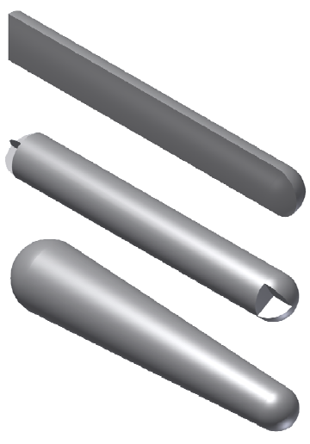
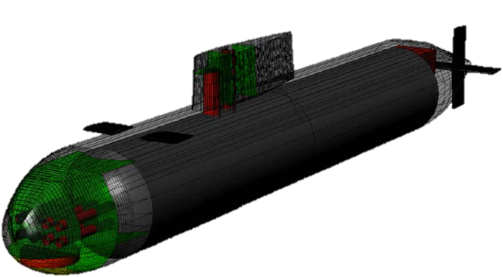
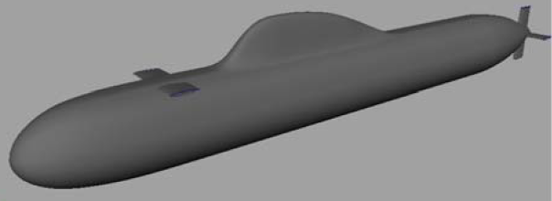
BeTSSi II workshop
Organized by WTD71, DRDC Atlantic and TNO, 1st meeting Sept. 2-4, 2014, Kiel, Germany.
Simple rigid and elastic structures
Coating models
Generic “BeTSSi” submarine
“Stealth” submarine

Slide 13
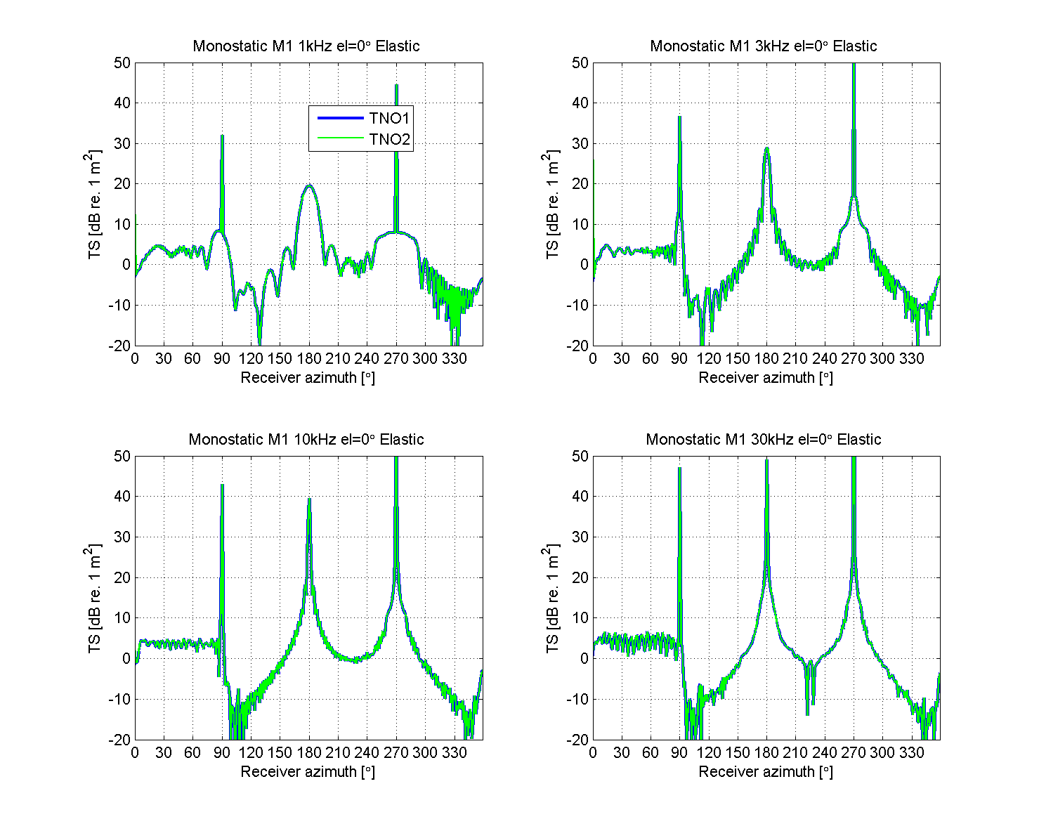
BeTSSi II
Structure M1: Cut circular tube with flat and rounded ends
Convex structure
Air filled → almost pressure release
→ multi-path does not matter: same result without and with ray-tracing

Slide 14
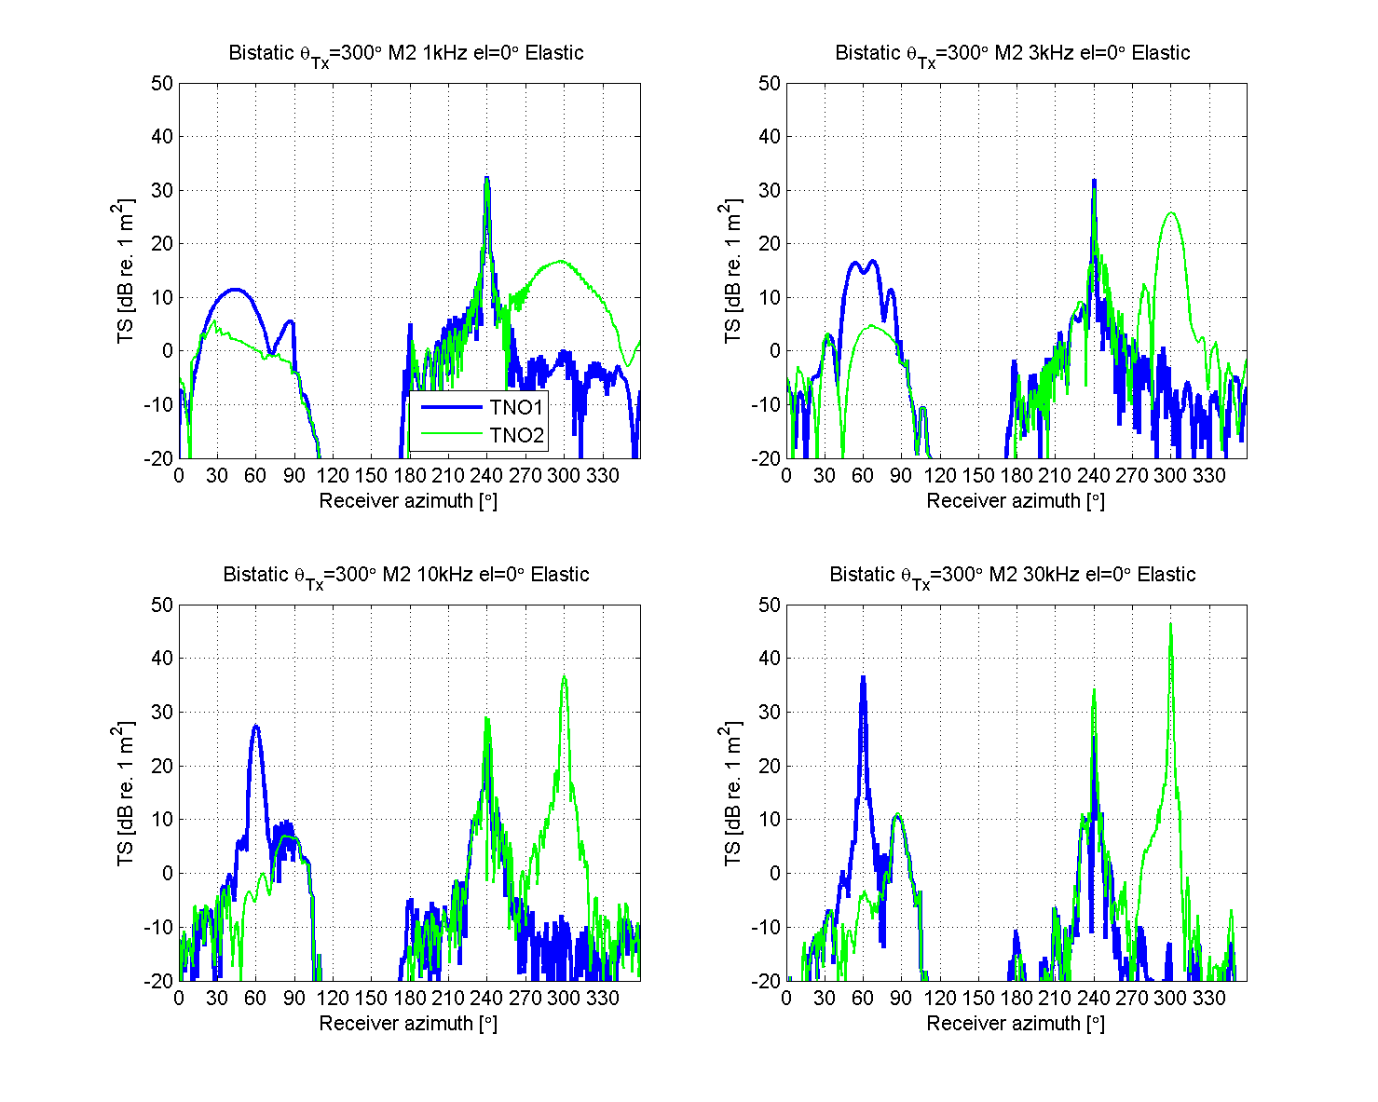
60°
300°
BeTSSi II
Corner reflector leads to return in the incident direction (300°). Here, raytracing matters!
This return is observed using the ray tracer (TNO2)
It is absent without (TNO1) and another peak is present instead at 60°, which is grossly overestimated because occlusion is not computed
240°

